Slide 1
Fractional Knapsack Problem
Knapsack capacity: W
There are n items: the i-th item has value v_{i} and weight w_{i}
Goal:
  find x_{i} such that for all 0 ≤ x_{i} ≤ 1, i = 1, 2, .., n
  ∑ w_{i}x_{i} ≤ W and
  ∑ x_{i}v_{i} is maximum

Slide 2
Fractional Knapsack - Example
50
20
---
30
50
E.g.:
$80
+
Item 3
Item 2
30
20
$100
+
Item 1
20
10
10
$60
$60
$100
$120
$240
$6/pound
$5/pound
$4/pound

Slide 3
Fractional Knapsack Problem
Greedy strategy 1:
  Pick the item with the maximum value
E.g.:
  W = 1
  w₁ = 100, v₁ = 2
  w₂ = 1, v₂ = 1
  Taking from the item with the maximum value:
  Total value taken = v₁/w₁ = 2/100
  Smaller than what the thief can take if choosing the other item
  Total value (choose item 2) = v₂/w₂ = 1

Slide 4
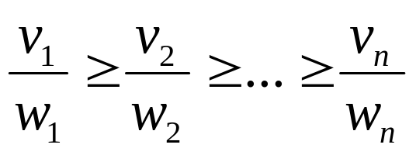
Fractional Knapsack Problem
Greedy strategy 2:
Pick the item with the maximum value per pound v_{i}/w_{i}
If the supply of that element is exhausted and the thief can carry more: take as much as possible from the item with the next greatest value per pound
It is good to order items based on their value per pound

Slide 5
Fractional Knapsack Problem
Alg.: Fractional-Knapsack (W, v[n], w[n])
While w > 0 and as long as there are items remaining
pick item with maximum v_{i}/w_{i}
x_{i} ← min (1, w/w_{i})
remove item i from list
w ← w – x_{i}w_{i}
w – the amount of space remaining in the knapsack (w = W)
Running time: Θ(n) if items already ordered; else Θ(nlgn)

Slide 6
Example
Knapsack capacity = 10 Kg
Items | 1 | 2 | 3 | 4 | 5
Weights (in kg) | 3 | 3 | 2 | 5 | 1
Profits | 10 | 15 | 10 | 20 | 8
P_{i}/W_{i} | 3.3 | 5 | 5 | 4 | 8
Items sorted based on Pi/Wi | 5 | 2 | 3 | 4 | 1
Weights (in kg) | 1 | 3 | 2 | 5 | 3
Profits | 8 | 15 | 10 | 20 | 10
Knapsack | 1 | 1 | 1 | 4/5 | 0
Knapsack will hold = [(1 * 1) + (1 * 3) + (1 * 2) + (4/5 * 5)] = 10
Max profit = [(1 * 8) + (1 * 15) + (1 * 10) + (4/5 * 20)] = 37

